Slide 1
School 0f DevOps
Python
Ivan Adji - Krstev
ENDAVA

Slide 2
PYTHON
Conditional statements
Iterators
Method and Functions
Inheritance
Sequence types

Slide 3
Sequences
In Python programming, sequences are a generic term for an ordered set which means that the order in which we input the items will be the same when we access them.
Python supports six different types of sequences.
strings
lists
tuples
byte sequences
byte arrays
range objects

Slide 4
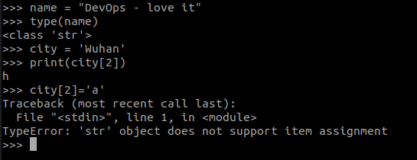
Python Strings
Strings are a group of characters written inside a single or double-quotes.
Strings are immutable in nature so we can reassign a variable to a new string but we can’t make any changes in the string.

Slide 5
Python String
stringliteral: shortstring | longstring
shortstring: "'" shortstringitem* "'" | '"' shortstringitem* '"'
longstring: "'''" longstringitem* "'''" | '"""' longstringitem* '"""'
shortstringitem: shortstringchar | escapeseq
longstringitem: longstringchar | escapeseq
shortstringchar: <any ASCII character except "\" or newline or the quote>
longstringchar: <any ASCII character except "\">
escapeseq: "\" <any ASCII character>
Notes:
String literals can be enclosed in matching single quotes (') or double quotes ("). They can also be enclosed in matching groups of three single or double quotes.
The backslash (\) character is used to escape characters that otherwise have a special meaning, such as newline, backslash itself, or the quote character.
Single quotes are used to mark a quote within a quote or a direct quote in a news story headline.
When programming with Python, we generally use single quotes for string literals.
A double quotation mark is to set off a direct (word-for-word) quotation.
we use Double Quotes for string representation.
What if you have to use strings that may include both single and double quotes? For this, Python allows you to use triple quotes
Triple quotes also allow you to add multi-line strings to Python variables instead of being limited to single lines.

Slide 6
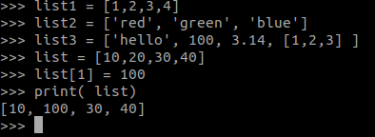
Python List
Python lists are similar to an array but they allow us to create a heterogeneous collection of items inside a list. A list can contain numbers, strings, lists, tuples, dictionaries, objects, etc.
Lists are declared by using square brackets around comma-separated items.
Lists are mutable which makes it easier to change and we can quickly modify a list by directly accessing it.

Slide 7
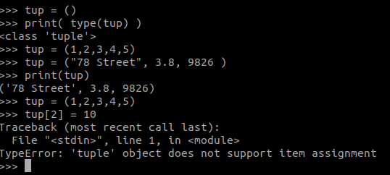
Python Tuples
Tuples are also a sequence of Python objects. A tuple is created by separating items with a comma. They can be optionally put inside the parenthesis () but it is necessary to put parentheses in an empty tuple.
A single item tuple should use a comma in the end.
Tuples are also immutable like strings so we can only reassign the variable but we cannot change, add or remove elements from the tuple.
Notes:
Unlike lists, tuples cannot be modified. You cannot add, remove, or replace an item within a tuple. Using a list may be more appropriate if you intend to modify the values you want to store.
That said, you can concatenate two or more tuples, which means that you can combine two tuples to form a new one.
To modify the contents of a tuple, we need to convert it into a list. Then, we can convert our list back into a tuple
The key difference between the tuples and lists is that while the tuples are immutable objects the lists are mutable. This means that tuples cannot be changed while the lists can be modified.
When to use TUPLE
There may be some occasions you specifically do not what data to be changed. If you have data which is not meant to be changed in the first place, you should choose tuple data type over lists.
But if you know that the data will grow and shrink during the runtime of the application, you need to go with the list data type.

Slide 8
Python Bytes Sequences
The bytes() function in Python is used to return an immutable bytes sequence. Since they are immutable, we cannot modify them.
If you want a mutable byte sequence, then it is better to use byte arrays. This is how we can create a byte of a given integer size.
Notes:
print(bytes(1))
print(bytes(2))
print(bytes(3))
print(bytes('Hello World','utf-8'))

Slide 9
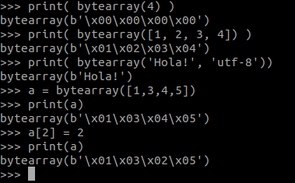
Python Byte Arrays
Byte arrays are similar to bytes sequence. The only difference here is that byte arrays are mutable while bytes sequences are immutable. So, it also returns the bytes object the same way.
Since byte arrays are mutable, let’s try changing a byte from the array.
Notes:
The bytearray() method returns a bytearray object which is an array of the given bytes.
prime_numbers = [2, 3, 5, 7]
# convert list to bytearray
byte_array = bytearray(prime_numbers)
print(byte_array)

Slide 10
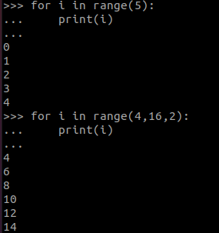
Python range() objects
range() is a built-in function in Python that returns us a range object. The range object is nothing but a sequence of integers. It generates the integers within the specified start and stop range.
The first argument is the starting range, the second argument is the stopping range and the third argument tells how many steps to take.

Slide 11
Conditional Statements
Sequential execution, in which statements are always performed one after the next, in exactly the order specified.
Decision-making is as important in any programming language as it is in life.
Decision-making in a programming language is automated using conditional statements.
A control structure directs the order of execution of the statements in a program.
Notes:
Everything you have seen so far has consisted of sequential execution, in which statements are always performed one after the next, in exactly the order specified.
But the world is often more complicated than that. Frequently, a program needs to skip over some statements, execute a series of statements repetitively, or choose between alternate sets of statements to execute.
That is where control structures come in. A control structure directs the order of execution of the statements in a program (referred to as the program’s control flow).
Here’s what you’ll learn in this tutorial: You’ll encounter your first Python control structure, the if statement.
https://realpython.com/python-conditional-statements/

Slide 12
If, elif and else Statements in Python
program needs to skip over some statements, execute a series of statements repetitively, or choose between alternate sets of statements to execute.
A control structure directs the order of execution of the statements in a program - control flow
If
elif
else

Slide 13
Control flow
Control flow syntax makes use of colons and indentation (whitespace)
This indentation system is crucial to Python and is what sets it apart from other programing languages.
This use of whitespace, an indentation allows Python code to be easily readable and very quick to prototype.

Slide 14
Python PEP8
Check together
Syntax check
Flake8

Slide 15
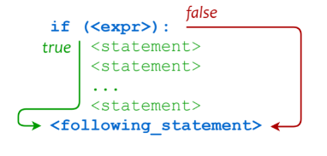
Indentation
if <expr>:
<statement>
<statement>
...
<statement>
<following_statement>

Slide 16
IF
Syntax of “if” statement
if some_condition:
# execute some code
else:
# do something else
Multiple conditions
if some_condition:
# execute some code
elif some_other_condition:
# do something different
else:
# do something else

Slide 17
One-Line if Statements
Syntax:
value_1 if condition else value_2
Example:
age = 15
print('kid' if age < 18 else 'adult')
Notes:
age = 15
print('kid' if age < 18 else 'adult')

Slide 18


Functions vs Methods
A function is a block of code to carry out a specific task, will contain its own scope and is called by name.
All functions may contain zero(no) arguments or more than one arguments.
On exit, a function can or can not return one or more values.
Notes:
https://www.tutorialspoint.com/difference-between-method-and-function-in-python

Slide 19
Functions
def name_of_function(name):
“””
Docstrings explains function.
“””
print(“Hello” + name)

Slide 20
Functions
Three type of functions:
Built-in functions As the name suggests, these functions come with the Python language, for example, help() to ask for any help, max()- to get maximum value, type()- to return the type of an object or print() and many more.
User-defined functions These are the functions that users create to help them, to do something that is user defined.
Anonymous Functions also called lambda functions and unlike normal function which is defined using def keyword are defined using lambda keyword.
Notes:
# Built in Functions
# print()
# help(print)
# type(something)
#######################################################
# Lambda
#lambda argument(s): expression
x = lambda a : a + 10
print(x(5))
test = lambda a,b: a+b
print(test(10,10))
list_1 = [1,2,3,4,5,6,7,8,9]
print(list(filter(lambda x: x%2==0, list_1)))
####################################
Extra:
# Print vs Return
def print_result(a,b):
print(a+b)
print(100*"=")
test_print = print_result(2,3) # Print the result as the function is called
print(test_print) # None as its not saving the results - it just printing it
def retur_result(a,b):
return a+b
print(retur_result(3,3))

Slide 21
Functions
*args and **kwargs

Slide 22
Functions
*args
The special syntax *args in function definitions in python is used to pass a variable number of arguments to a function. It is used to pass a non-key worded, variable-length argument list.
The syntax is to use the symbol * to take in a variable number of arguments; by convention, it is often used with the word args.
What *args allows you to do is take in more arguments than the number of formal arguments that you previously defined. With *args, any number of extra arguments can be tacked on to your current formal parameters (including zero extra arguments).
For example : we want to make a multiply function that takes any number of arguments and able to multiply them all together. It can be done using *args.
Using the *, the variable that we associate with the * becomes an iterable meaning you can do things like iterate over it, run some higher-order functions such as map and filter, etc.
Notes:
# Parameters and default par.
def some_f(name='Default par'):
print(name)
#########################################################
# *args and **kwargs
def my_sum(*args):
return sum(args)

Slide 23
Functions
The special syntax **kwargs in function definitions in python is used to pass a keyworded, variable-length argument list. We use the name kwargs with the double star. The reason is because the double star allows us to pass through keyword arguments (and any number of them).
A keyword argument is where you provide a name to the variable as you pass it into the function.
One can think of the kwargs as being a dictionary that maps each keyword to the value that we pass alongside it. That is why when we iterate over the kwargs there doesn’t seem to be any order in which they were printed out.
Notes:
# Python program to illustrate
# *kwargs for variable number of keyword arguments
def myFun(**kwargs):
for key, value in kwargs.items():
print ("%s == %s" %(key, value))
# Driver code
myFun(first ='Geeks', mid ='for', last='Geeks')

Slide 24
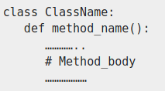
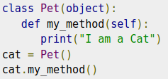
Methods
Methods are essentially functions that are built into objects.
The method is implicitly used for an object for which it is called.
The method is accessible to data that is contained within the class.

Slide 25
OOP and Class
A class is a user-defined blueprint or prototype from which objects are created.
Creating a new class creates a new type of object, allowing new instances of that type to be made.
Each class instance can have attributes attached to it for maintaining its state.
A Class is like an object constructor, or a "blueprint" for creating objects.
Class creates a user-defined data structure, which holds its own data members and member functions, which can be accessed and used by creating an instance of that class. A class is like a blueprint for an object.
Notes:
Object Oriented Programming allows us to create our own objects that have methods and attributes .
In general, the whole concept is to allow us to create code that is repeatable and organized.
And at a certain scale, you're going to need to understand how to work with object oriented programming
in order to make sure your programs themselves are flexible.
And when you're working with outside libraries, you'll see how they make use of object oriented programming
and a lot of their code.
For much larger scripts of Python code, functions by themselves aren't going to be enough for
Organization and generic.
commonly repeated tasks and objects can be defined with OOP to create code that is more usable, especially across organization.

Slide 26
Class - self and __init__()
Class functions that begin with double underscore __ are called special functions as they have special meaning.
Of one particular interest is the __init__() function. This special function gets called whenever a new object of that class is instantiated.
The self is used to represent the instance of the class. With this keyword, you can access the attributes and methods of the class in python. It binds the attributes with the given arguments.

Slide 27
Object Oriented Programming
Inheritance is the capability of one class to derive or inherit the properties from another class
The benefits of inheritance are:
It represents real-world relationships well.
It provides reusability of a code. We don’t have to write the same code again and again. Also, it allows us to add more features to a class without modifying it.
It is transitive in nature, which means that if class B inherits from another class A, then all the subclasses of B would automatically inherit from class A.
Notes:
class Person:
def __init__(self, name, age):
self.name = name
self.age = age
p1 = Person("John", 36)
print(p1.name)
print(p1.age)
class Person:
"This is a person class"
age = 10
def greet(self):
print('Hello')
# Output: 10
print(Person.age)
# Output: <function Person.greet>
print(Person.greet)
# Output: "This is a person class"
print(Person.__doc__)

Slide 28
Questions

Slide 29
https://forms.office.com/r/Xj84LaUtt3

